Slide 1
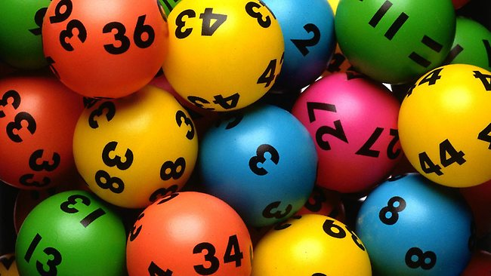
Lotto game

Slide 2
Word Lotto
선생님이 보여주는 단어 중에서 3개를 골라 영어 공책에 적으세요.
3개 모두 일치 : 3점 2개 일치 : 2점
1개 일치 : 1점

Slide 3
Word Lotto 1
music
P.E.
subject
science
like
Korean
problem
math
favorite

Slide 4
Word Lotto 2
art
music
P.E.
like
favorite
science
problem
subject
English

Slide 5
Word Lotto 3
English
science
math
Korean
like
art
problem
favorite
subject

Slide 6
Word Lotto 4
music
P.E.
like
Korean
English
subject
math
problem
favorite

Slide 7
Word Lotto 5
art
math
science
P.E.
problem
Korean
like
music
subject

Slide 8
Word Lotto 6
art
P.E.
music
like
English
problem
favorite
math
science

Slide 9
Word Lotto 7
art
science
Korean
music
favorite
English
subject
problem
P.E.

Slide 10
Word Lotto 8
Korean
like
art
subject
English
P.E.
favorite
science
math

Slide 11
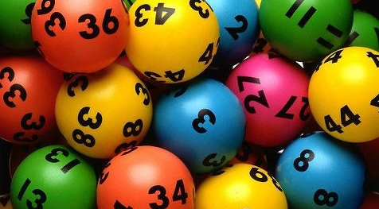
Count your score! 5~9점(간식1개), 10~14(간식2개), 15~(간식3개)

